Slide 1
NBA Player Performance Dashboard
Data Visualization Project 1
CSCE 5320 - Data Visualization
2024-2025 NBA Season Analysis
Abhijit Sappidi
11723306

Slide 2
Introduction
NBA teams spend billions on player salaries, yet not all high-paid players deliver proportional on-court performance. Before analyzing salary efficiency, we must first understand the performance landscape: Who are the top performers? How do stats vary by position and role?
Project 1 Focus:
Explore, clean, and visualize the 2024-25 NBA Player Stats dataset to uncover performance patterns, positional differences, and statistical correlations.
Project 2 Preview (Future):
Integrate salary data to compute Performance Value Index and identify undervalued vs. overpaid players.

Slide 3
Problem Statement
Core Questions We Answer in Project 1:
1. Who are the top-performing NBA players in the 2024-25 season?
2. How does performance vary across positions? (Point Guards vs. Shooting Guards vs. Centers)
3. Which performance metrics correlate most strongly with overall player efficiency?
4. What does the scoring distribution look like across all NBA players — and where is the elite tier?
Domain: NBA Sports Analytics
Audience: Team management, coaches, scouts, fantasy analysts

Slide 4
Project Objectives
✔ Import and explore the 2024-25 NBA player stats dataset
✔ Clean data — handle missing values, filter low-game players, standardize position labels
✔ Create 8 static visualizations covering distributions, positional comparisons, and correlations
✔ Perform correlation analysis : identify which stats predict overall player efficiency (PER)
✔ Generate summary insights by position and performance tier
✔ Build dashboards in Tableau and Power BI

Slide 5
Dataset Details
Dataset 1: NBA Player Stats 2024-25 (Per Game)
Source: Kaggle — ratin21
URL: kaggle.com/datasets/ratin21/nba-player-stats-2024-25-per-game
Type: Structured CSV
Raw Size: 735 rows × 30+ columns
Cleaned: 590 players × 32 columns (after filtering G ≥ 15)
Key Columns Used:
• Player, Pos, Team, Age, G (Games Played) PTS (Points Per Game) TRB (Total Rebounds Per Game) AST (Assists Per Game) STL, BLK, TOV, FG%, 3P%, FT% (Shooting Percentages) USG% (Usage Rate) from Advanced Stats PER (Player Efficiency Rating) from Advanced Stats

Slide 6
Methodology - Data Collection & Cleaning
Data Sources:
• Basketball-Reference.com (Per-game and Advanced statistics)
• Initial dataset: 735 players
Data Cleaning Steps (Python/Pandas):
1. Handled traded players - kept TOT (Total) rows for full season stats
2. Filtered minimum 15 games played for statistical significance
3. Simplified positions to 5 main categories (PG, SG, SF, PF, C)
4. Converted all statistics to numeric format
5. Merged per-game stats with advanced metrics (PER, USG%)
6. Removed missing values and duplicates
Final Cleaned Dataset: 590 players with 32 attributes

Slide 7
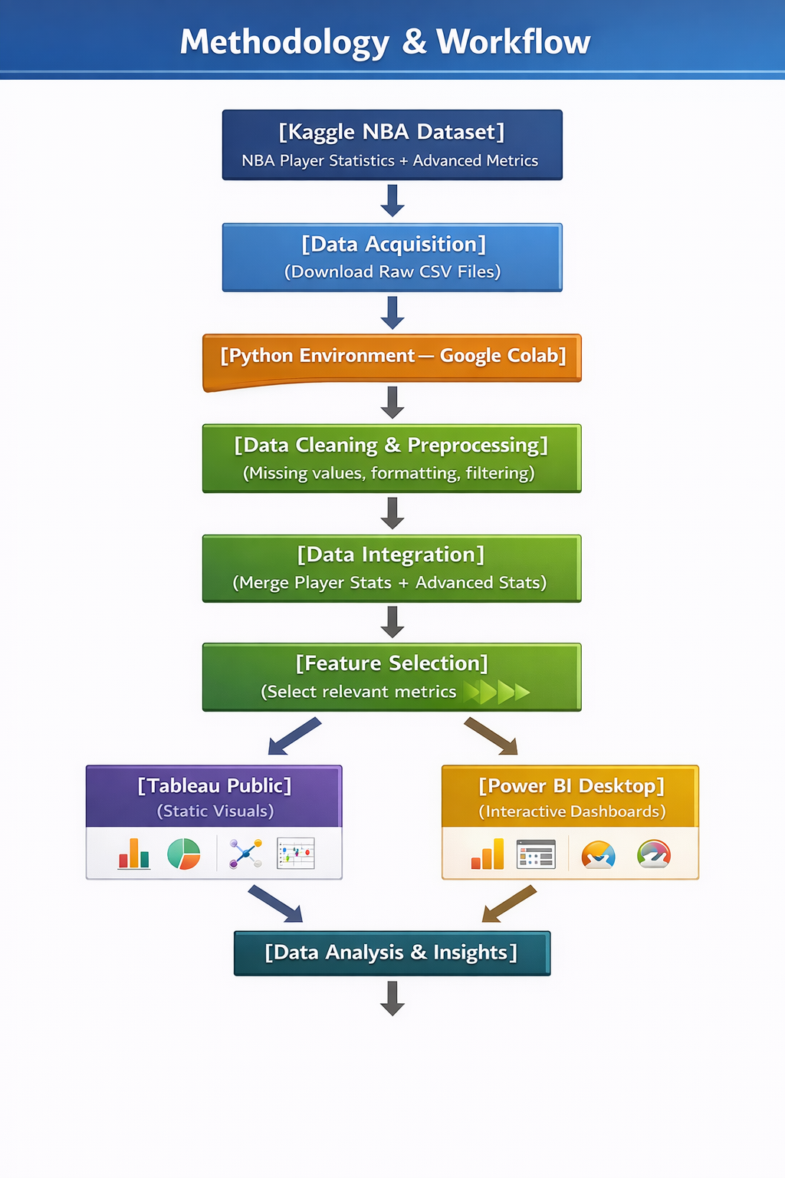

Slide 8
Task Abstraction
ACTIONS — Methods Used:
1. Distribution Analysis → Histogram of PTS to understand scoring spread
2. Positional Aggregation → Box plots of PTS, TRB, AST grouped by position
3. Correlation Analysis → Scatter plots: USG% vs PER, FG% vs PTS
→ Heatmap: correlation matrix of all key metrics
4. Comparative Aggregation → Grouped bar chart: avg PTS, REB, AST by position
Tools: Python (Matplotlib, Seaborn), Tableau, Power BI

Slide 9
Tools Used
Tool 1: Python (Google Colab)
• Pandas — data loading, cleaning, merging, filtering, NumPy — numerical operations, correlation calculations,Matplotlib — chart generation (VIZ 1-8),Seaborn — heatmap and styled visualizations
Output: 8 PNG chart files + cleaned CSV
Tool 2: Tableau Public (Free)
• Connected to nba_stats_cleaned.csv Built 4 charts: Bar, Box Plot ×2, Scatter,Saved as: tableau_dashboard.twbx
Tool 3: Microsoft Power BI Desktop (Free)
• Connected to nba_stats_cleaned.csv, Built 4 charts: Bar, Table, Scatter ×2, Saved as: powerbi_dashboard.pbix
Data Flow:Raw CSVs → Python Cleaning → Cleaned CSV→ Tableau + Power BI → Dashboards + Screenshots

Slide 10
How Data Was Loaded
Step 1: Uploaded 3 CSV files to Google Colab:
• NBA Player Stats_2024-25_2.csv (per-game stats)
• NBA Player Advanced Stats_2024-25.csv (PER, USG%)
• NBA Player Stats_2024-25_Total.csv (totals — reference)
Step 2: Loaded in Python using:pg = pd.read_csv('NBA Player Stats_2024-25_2.csv') adv = pd.read_csv('NBA Player Advanced Stats_2024-25.csv')
Step 3: Merged on Player column: df = pg_clean.merge(adv_clean, on='Player', how='left')
Step 4: Loaded cleaned CSV into Tableau: Connect → Text File → nba_stats_cleaned.csv
Step 5: Loaded cleaned CSV into Power BI: Get Data → Text/CSV → nba_stats_cleaned.csv

Slide 11
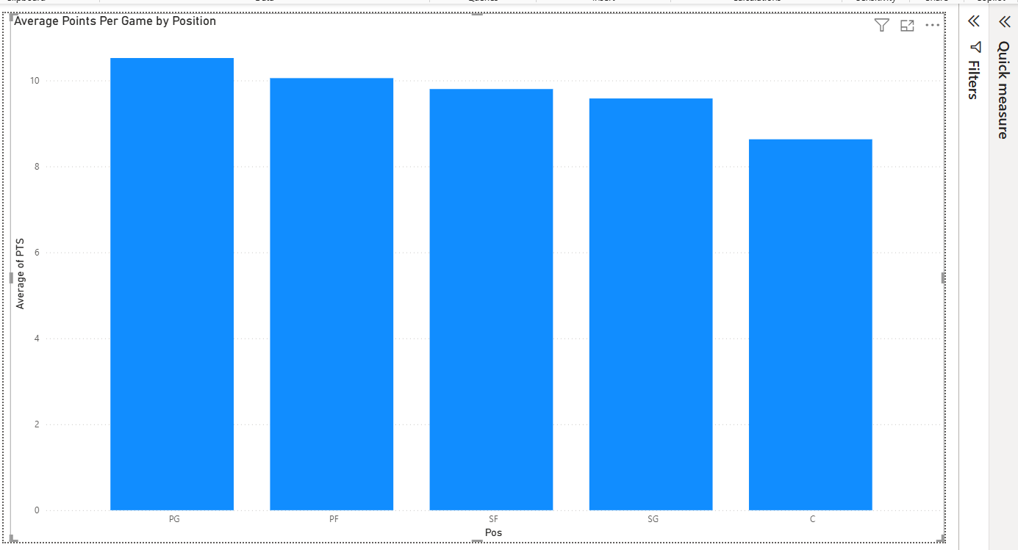
VIZ 1 — Average Points Per Game by Position
Tool: Power BI | Chart Type: Clustered Column Chart

Slide 12
VIZ 1 — Average Points Per Game by Position
A column chart displaying the average points per game for each of the 5 NBA positions across 590 players in the 2024-25 season.
KEY INSIGHTS:→ Point Guards (PG) lead all positions with ~10.52 avg PPG confirming their primary ball-handling and scoring role
→ Centers (C) have the lowest average at ~8.63 PPG their role is interior defense and rebounding, not scoring
→ Power Forwards (PF) rank second at ~10.05 PPG showing the evolution of the stretch big man in modern NBA
→ The difference between highest (PG: 10.52) and lowest (C: 8.63) is only ~1.9 points — scoring is more evenly distributed across positions than commonly assumed
This is our first look at positional scoring differences: establishing the performance baseline for the entire analysis.

Slide 13
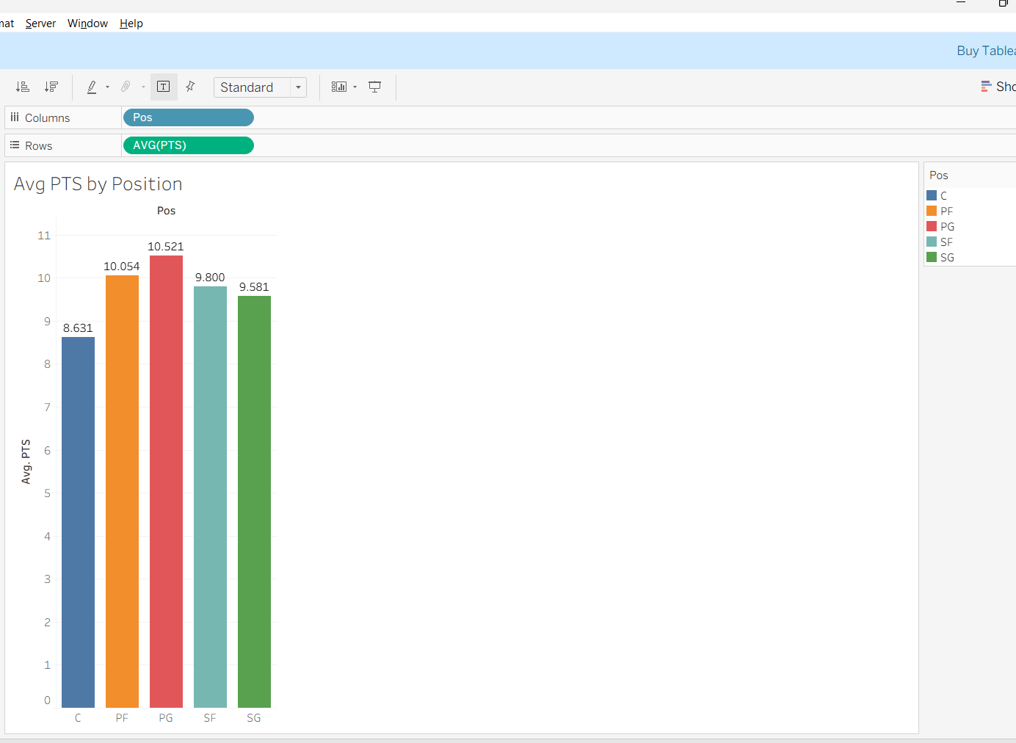
VIZ 2: Tableau Bar Chart

Slide 14
VIZ 1 — Average Points Per Game by Position
Tableau's version of average points per game by position,
with each bar color-coded by position for clear differentiation. Exact values labeled on top of each bar.
KEY INSIGHTS:
→ PG leads at 10.521 PPG — consistent with Power BI findings, confirming data accuracy across both visualization tools
→ Tableau's color-coding (blue=C, orange=PF, red=PG, teal=SF, green=SG) makes positional comparison instant
→ The labeled values (8.631, 10.054, 10.521, 9.800, 9.581) provide precise reference points for positional analysis
→ Cross-tool consistency: Both Tableau and Power BI produce identical results, validating our cleaned dataset
Tableau's automatic color-by-dimension and value labels make positional comparisons more visually intuitivecompared to Power BI's single-color default bars.

Slide 15
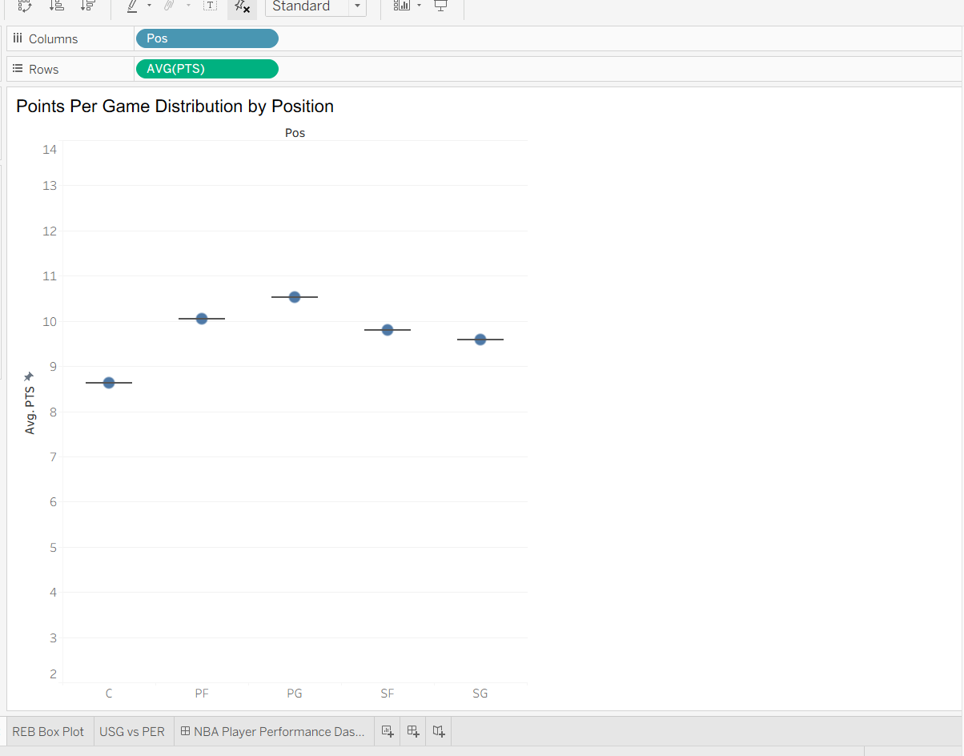
VIZ 3: Tableau PTS Box Plot

Slide 16
TABLEAU PTS BOX PLOT
A box-and-whisker plot showing the full distribution of points per game for each position — not just the average,but the spread, median, range, and outliers for all 590 players.
KEY INSIGHTS:
→ PG has the highest median and widest spread — Point Guards range from bench players (3-4 PPG) to superstars (32+ PPG) showing the biggest performance gap of any position
→ SF (Small Forwards) show the second-highest median,reflecting the versatile scoring role in modern offenses
→ C (Centers) show a tight cluster at lower values :most centers score modestly, with a few elite exceptions
like Nikola Jokic (29.6 PPG) as clear outliers
→ The whiskers reveal that EVERY position has significant variance — no position is uniformly high or low scoring
WHY BOX PLOT OVER BAR CHART:The bar chart (VIZ 1 & 2) only shows averages. This box plot reveals the FULL story the range,outliers, and spread that averages hide completely.

Slide 17
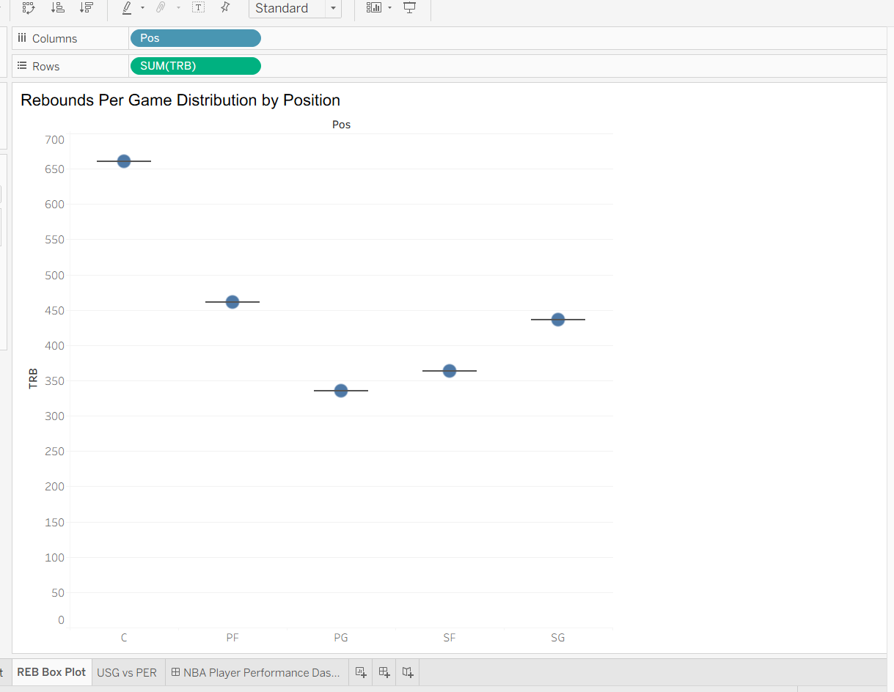
Tableau REB Box Plot

Slide 18
Tableau REB Box Plot
A distribution plot comparing total rebounds per game across all 5 positions, revealing the strong positional
separation in rebounding roles in the NBA
→ Centers (C) completely dominate rebounding — their median is dramatically higher than every other position,
with total TRB sum of ~650 confirming interior dominance
→ Power Forwards (PF) are clear second with ~450 total — frontcourt players (C + PF) together own the glass
→ Point Guards (PG) have the lowest rebounding at ~260 —guards focus on ball handling and scoring, not boards
→ The separation between frontcourt (C, PF) and backcourt(PG, SG) is the most dramatic positional split of any
statistical category in this entire analysis
→ This confirms: rebounding is the most position-defined stat in the NBA — more so than scoring or assists
Rebounding tells us more clearly than any other stat exactly what role each position plays on the court.

Slide 19
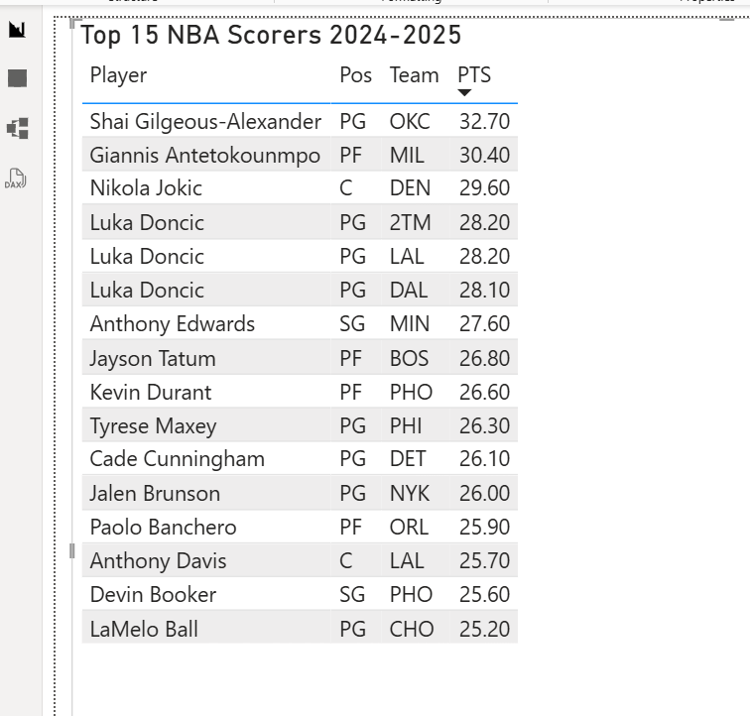
VIZ 5: Power BI Top 15 Table

Slide 20
Power BI Top 15 Table
A filtered and sorted table displaying the top 15 highest-scoring NBA players in the 2024-25 season,
showing Player, Position, Team, and Points Per Game.
KEY INSIGHTS:
→ Shai Gilgeous-Alexander (OKC) leads the league at 32.70 PPG — the only player above 32 PPG this season
→ Giannis Antetokounmpo (MIL) at 30.40 PPG is the top scoring big man, challenging traditional position roles
→ Nikola Jokic (DEN) at 29.60 PPG proves Centers can be elite scorers — breaking the "centers don't score" myth
→ Point Guards dominate the top 15 list — PG appears most frequently, confirming the modern NBA is guard-driven
→ The gap between #1 (SGA: 32.7) and #15 (LaMelo: 25.2) is only 7.5 points — the elite tier is tightly clustered
→ Multiple teams appear: OKC, MIL, DEN, MIN, BOS elite scoring is spread across the entire league.
Putting real names and numbers to the elite tier weidentified in our distribution analysis.

Slide 21
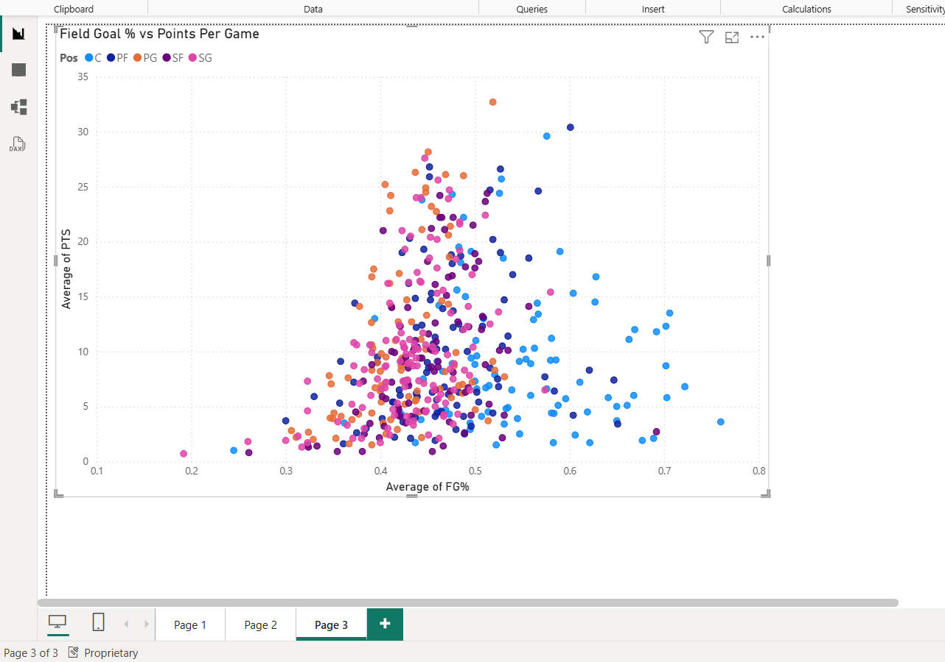
Power BI FG% vs PTS Scatter

Slide 22
Power BI FG% vs PTS Scatter
A scatter plot with one dot per player showing the relationship between shooting efficiency (FG%) on the
X-axis and scoring output (PTS) on the Y-axis.Each color represents a different position.
→ WEAK positive correlation — high FG% does NOT guarantee high scoring. Many high-FG% players score modestly
→ The highest scorers (25-35 PPG, top of chart) cluster around FG% of 0.45-0.55 — not the highest FG% range
→ Centers (C, blue dots) appear right side of X-axis with high FG% (0.55-0.75) due to interior high-percentage shots but their PTS remains moderate — they are efficient, not high-volume
→ Guards (PG/SG) scatter widely across all FG% values :they take difficult long-range shots lowering efficiency
but are still the highest scorers due to pure volume
→ Scoring in the NBA is about VOLUME andUSAGE, not just shooting efficiency alone
First correlation explored — efficiency vs. volume trade-offreveals that FG% and scoring tell very different stories.

Slide 23
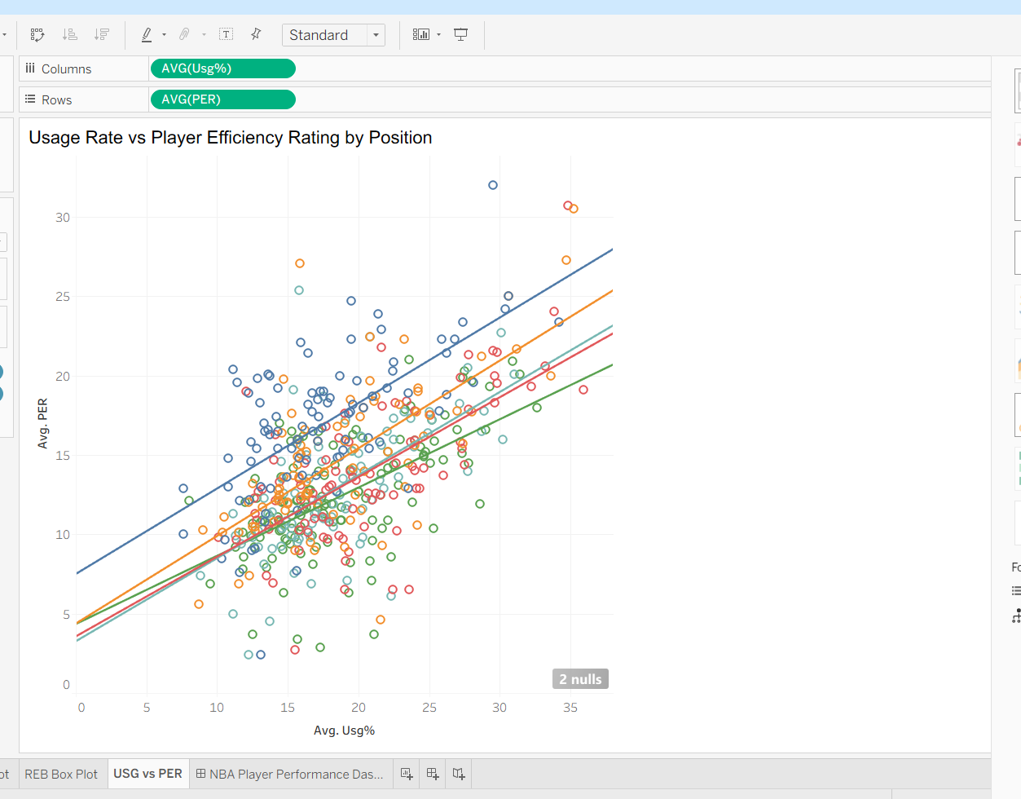
Tableau USG% vs PER Scatter

Slide 24
Tableau USG% vs PER Scatter
WHAT IT SHOWS:
A scatter plot with one dot per player comparing Usage Rate (USG%) on X-axis vs Player Efficiency Rating (PER) on Y-axis, colored by position with separate linear trend lines for each position.
→ POSITIVE CORRELATION across all positions as USG% increases, PER generally increases too
confirming that coaches give the ball to their best players
→ Each position has its own trend line showing different efficiency slopes — Centers have the steepest slope
meaning small usage increases yield large PER gains for bigs
→ Top-right cluster (high USG%, high PER) = true superstars: players like SGA, Giannis, Jokic appear here
→ Bottom-left cluster (low USG%, low PER) = bench/role players who rarely touch the ball and contribute minimally
→ Outliers above trend lines = hidden gem players low usage but surprisingly high efficiency (undervalued)
→ Tableau's per-position trend lines (5 separate lines) reveal that this relationship holds TRUE for every
single position independently — not just overall This is the most important correlation in our analysis —USG% is the strongest predictor of player impact (PER)and sets the foundation for Project 2 salary analysis.

Slide 25
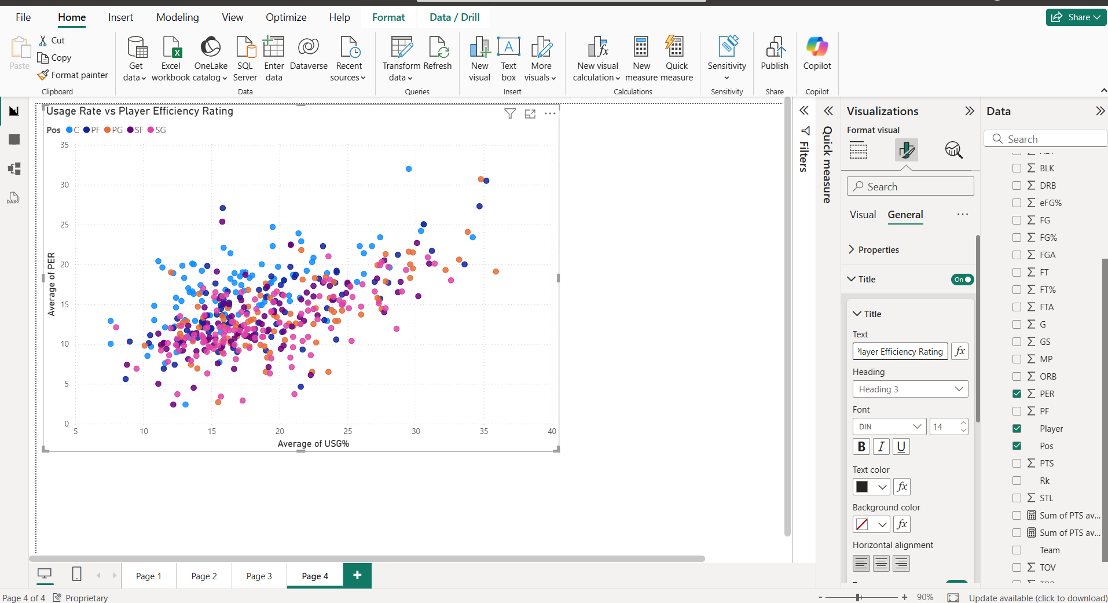
Power BI USG% vs PER Scatter

Slide 26
Power BI USG% vs PER Scatter
Power BI's version of the USG% vs PER scatter plot,providing cross-tool validation of the same correlation found in Tableau, with the same 590-player datasett
→ Results are CONSISTENT with Tableau (VIZ 7) — both tools confirm the positive USG% to PER relationship proving our data cleaning and analysis is accurate
→ The extreme outlier at top-right (USG%≈35+, PER≈30+) is almost certainly Nikola Jokic — the most efficient high-usage player in the entire NBA
→ Power BI shows the data in aggregated form (Average per player) making the central cluster more visible than Tableau's individual player dots — both views add value
→ Players below PER=10 with moderate usage represent inefficient role players being overused by their teams
→ The positive trend is clear: teams should maximize usage for their most efficient players
CROSS-TOOL VALIDATION:Having both Tableau AND Power BI confirm identical patterns
gives us high confidence in our analytical conclusions.This dual-tool approach is a best practice in data visualization.

Slide 27
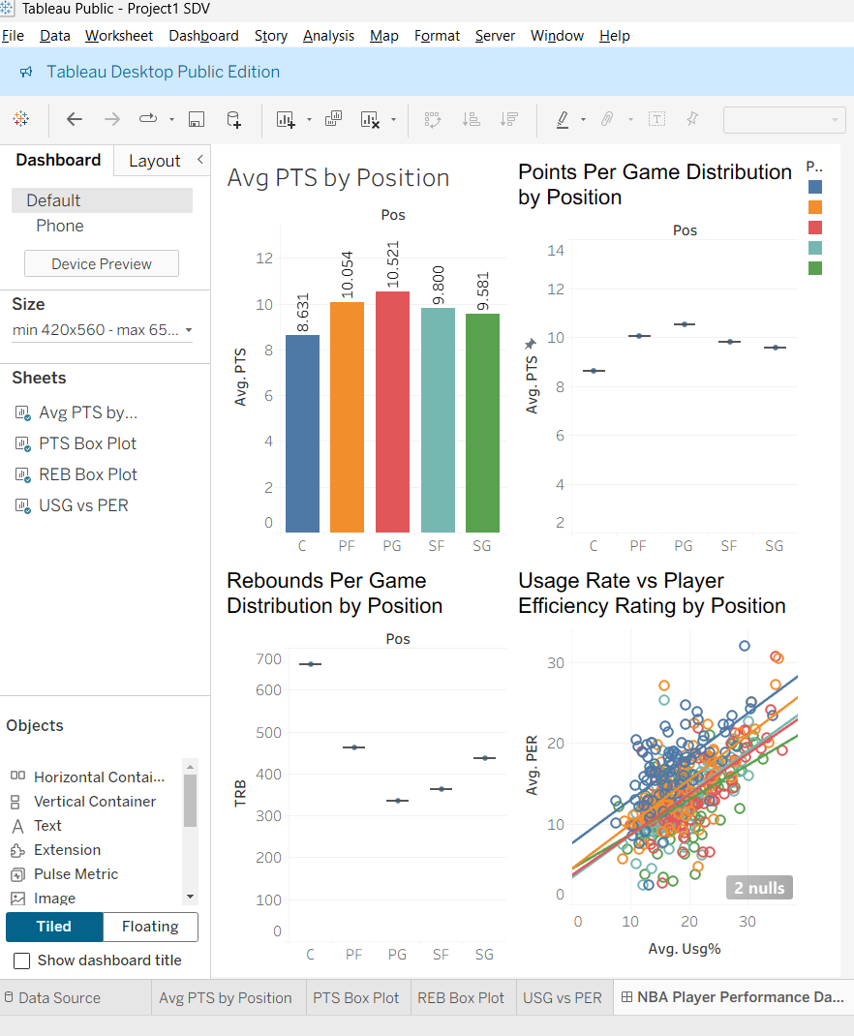
Tableau Dashboard

Slide 28
Color-coding by position is automatic and consistent across all 4 charts simultaneously
→ Box-and-whisker plots are native and easy to build
→ Trend lines per position on scatter plots add deep
analytical value not available in basic Power BI
→ The combined dashboard tells the complete Stage 1 and Stage 2 story in a single screen view

Slide 29
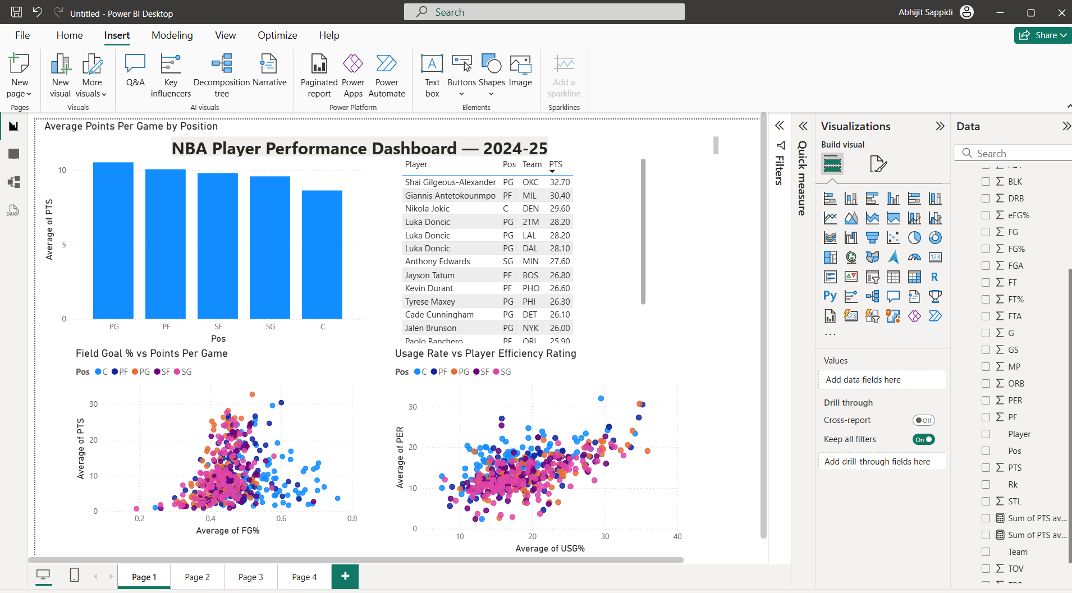
Power BI Dashboard

Slide 30
→ The Top 15 Scorers table is a unique addition not in Tableau — puts real player names to the data story
→ Top N filtering makes finding elite performers instant
→ Cross-visual interaction: clicking a position in the bar chart filters all other visuals simultaneously
→ Power BI's business intelligence focus makes it ideal for ranking and tabular analysis alongside charts
TABLEAU vs POWER BI — KEY DIFFERENCE:
Tableau excels at statistical charts (box plots, trend lines)
Power BI excels at business tables and interactive filtering.
Together they provide complete analytical coverage.

Slide 31
Project 2: From Performance to Value
Project 1 established the performance landscape of the 2024–25 NBA season by identifying top performers, positional differences, and the strongest statistical relationships.
Project 2 extends that analysis by adding salary data, allowing us to evaluate not just who performs well, but who delivers the best value for the money spent.
This shift turns a performance dashboard into a decision-support tool for contract evaluation, team-building, and salary efficiency analysis

Slide 32
Project 2 Dataset and Integration
Dataset 1: NBA Player Stats 2024–25 provided player performance variables such as PTS, TRB, AST, FG%, 3P%, FT%, USG%, and PER. Dataset 2: NBA Player Salaries 2024–25 added contract salary information used to measure cost versus performance. The two datasets were merged on player identity and team, producing a combined dataset for salary-efficiency analysis. This merged dataset became the foundation for all Project 2 charts, rankings, and dashboard interactions.
Stats dataset: player performance metrics
Salary dataset: annual player compensation
Merge key: player + team
Output: integrated player-value dataset

Slide 33
Data Cleaning for Project 2
The analysis pipeline was built in Python using Pandas and NumPy for cleaning, transformation, and feature engineering. For Project 1, traded players were handled by keeping the TOT season rows, players with fewer than 15 games were filtered out, positions were simplified into five main categories, all statistical columns were converted to numeric format, and duplicates or missing values were removed.
For Project 2, salary records were cleaned and merged with the performance dataset, creating a final player-level table ready for value analysis and dashboarding.
Kept TOT rows for traded players
Filtered G >= 15 for stability
Standardized positions to PG, SG, SF, PF, C
Converted key fields to numeric
Removed duplicates and missing values
Merged salary data for Project 2

Slide 34

Derived Metrics for Value Analysis
To move from raw performance to salary efficiency, derived features were created after the merge. The proposal defines a Performance Value Index using PER, Usage Rate, and Salary in Millions to capture the amount of on-court impact delivered per dollar spent. Players were also segmented into salary tiers such as minimum, role player, star, and superstar, enabling clearer comparisons between similar contract groups. These engineered variables made it possible to rank undervalued and overpaid players rather than simply listing top performers.
Performance Value Index

Slide 35
Salary vs Performance Bubble Chart
The main Project 2 visualization is a bubble chart with Salary on the x-axis, PER on the y-axis, and bubble size representing Usage Rate.
This chart helps separate expensive superstars, efficient mid-tier players, and low-cost high-value players in one view. Players above the expected salary-performance trend can be interpreted as undervalued, while players below it may be overpaid relative to peers.
Interactive filters by team, position, and salary tier make the chart useful for targeted roster analysis.

Slide 36
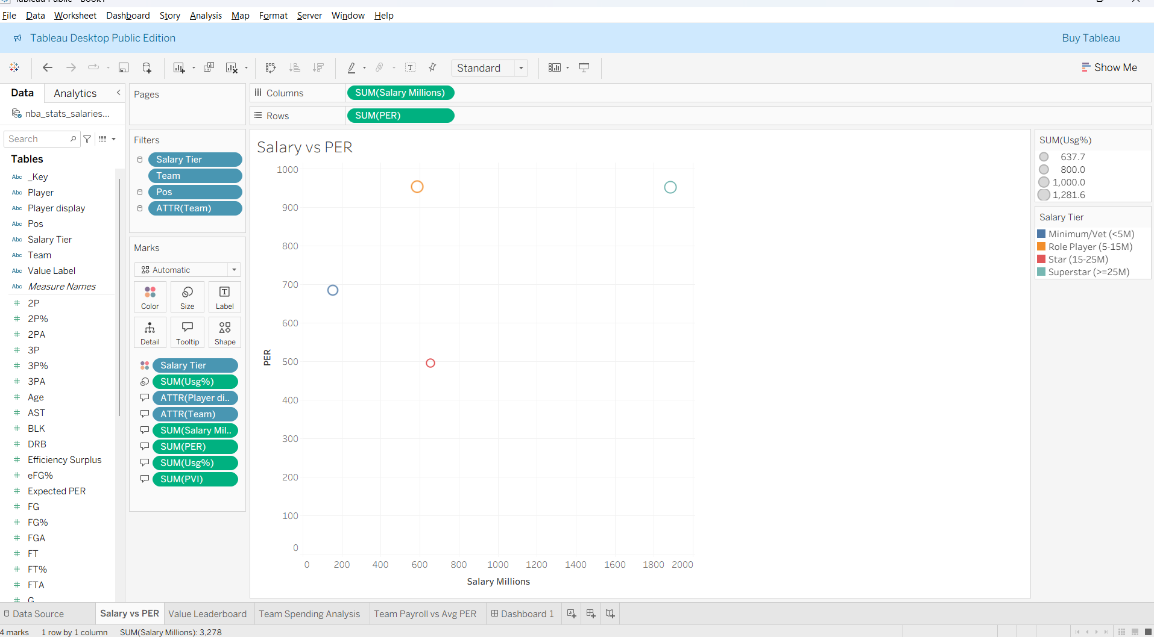

Slide 37
Value Leaderboard: Ranking Players by Efficiency per Dollar
A second view ranks players by value using the engineered efficiency metric and supporting statistics such as salary, PER, usage, and rank. This leaderboard makes it easy to identify low-salary, high-impact players who outperform their contract tier, as well as high-salary players with weaker-than-expected returns. Compared with a scatter plot, the leaderboard provides a more direct decision-making tool for analysts, coaches, and front-office staff.
Sortable by value score, salary, or PER
Filterable by team, position, and salary tier
Highlights undervalued vs overpaid players

Slide 38
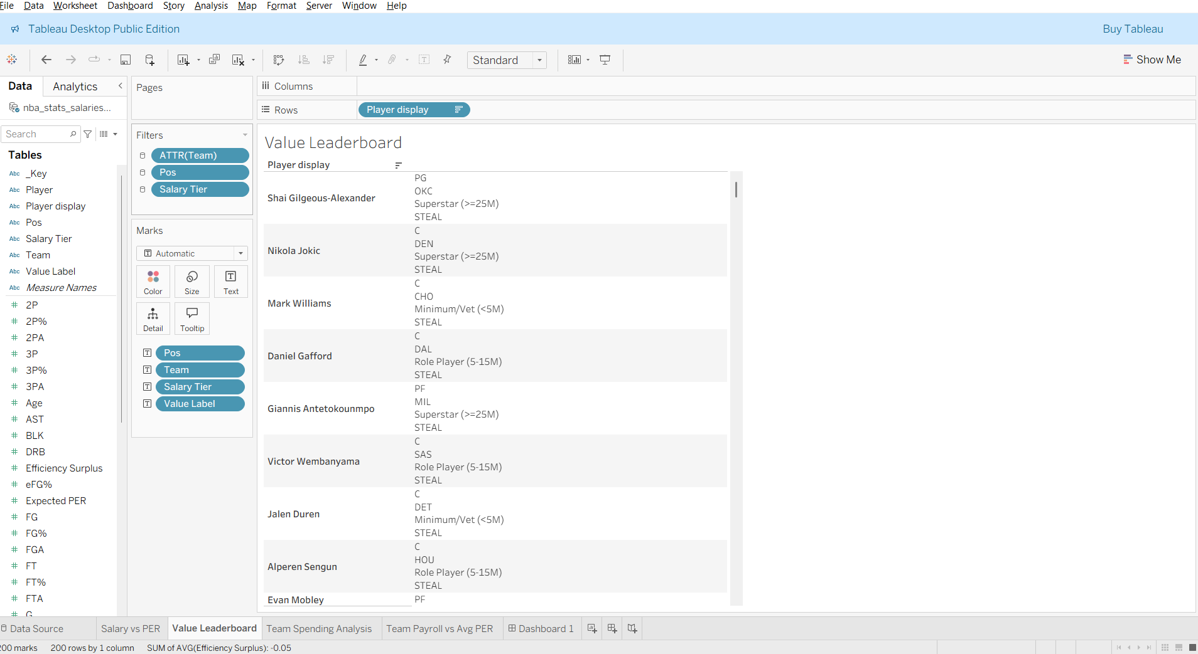

Slide 39
Team Spending Analysis
Project 2 also scales the analysis from players to franchises by comparing team payroll and average performance outcomes. The proposal recommends views such as average salary by team, average PER by team, team payroll versus team efficiency, and salary allocation by position. These charts help reveal which teams spend efficiently, which teams over-invest in certain positions, and which organizations get stronger returns from their payroll.
Some teams combine moderate payroll with strong average efficiency, suggesting better value allocation.
Others show high spending without equivalent performance returns, indicating weaker salary efficiency.

Slide 40
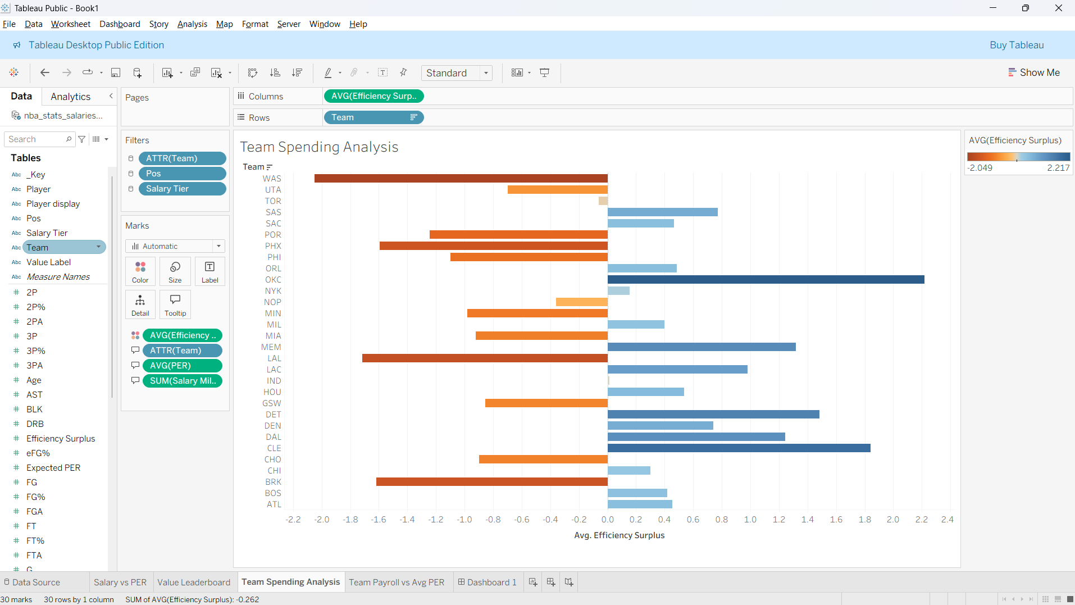

Slide 41
Interactive Dashboard
The final dashboard combines player-level and team-level views into one interactive analytical screen.
Users can filter by team, position, and salary tier, explore the salary-performance bubble chart, inspect the value leaderboard, and compare team spending patterns.
This design follows the proposal’s final storytelling stage, where analysis moves from static explanation to interactive decision-making.
The final project also includes a storytelling webpage that combines Python methodology, key findings from Project 1, the salary-efficiency results from Project 2, and embedded dashboard content.

Slide 42
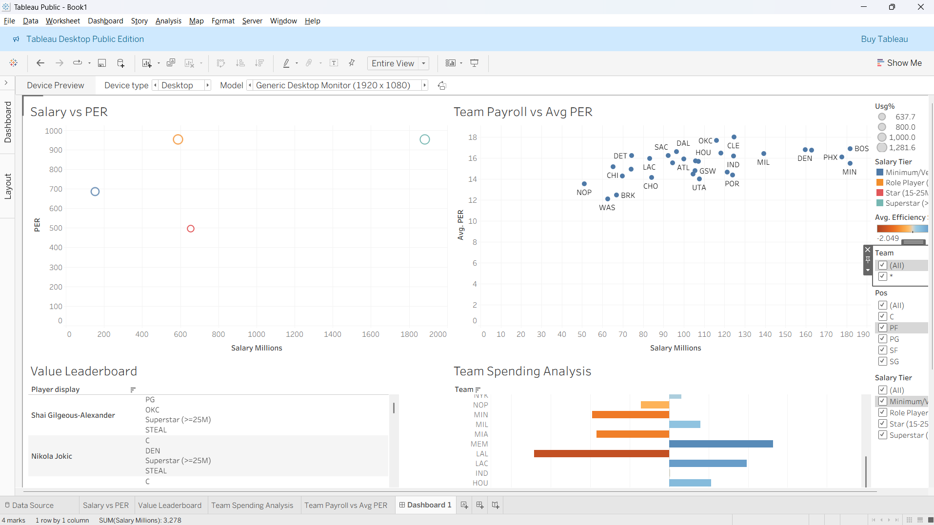

Slide 43
Key Findings Across Project 1 and Project 2
Project 1 showed that player performance differs meaningfully by position, especially in scoring, rebounding, and assists.
Usage Rate and PER showed a strong positive relationship, confirming that high-impact players are usually given larger offensive roles.
Salary adds a crucial second dimension: the best players are not always the best values.
Salary-efficiency analysis makes it possible to identify undervalued contributors and overpaid underperformers.
Team-level comparisons reveal that spending more does not automatically produce better efficiency outcomes.

Slide 44
Final Conclusions
This project shows that performance analysis alone is incomplete without financial context.
Project 1 identified the strongest player-performance patterns, positional differences, and efficiency relationships in the 2024–25 NBA season.
Project 2 extended that work by merging salary data and engineering a value metric to compare player impact against contract cost.
The combined analysis demonstrates that some lower-paid players provide exceptional value, while some highly paid players do not deliver proportional performance.
At the team level, salary efficiency varies significantly, meaning smarter roster construction depends on balancing cost, usage, and on-court production rather than chasing star salary alone.
Overall, the project turns raw NBA statistics into a practical framework for evaluating player value, team spending strategy, and data-driven decision-making.

Slide 45
Tools
Python (Pandas, NumPy, Matplotlib/Seaborn) for cleaning, merging, and feature engineering.
Tableau Public / Power BI for dashboard construction and interactive filtering.
Cleaned Project 1 dataset and merged Project 2 dataset.
Static visualizations from Project 1 and interactive dashboard views from Project 2.
Final storytelling webpage integrating methods, findings, and dashboard content.
Technical documentation covering schema, methodology, assumptions, and code structure

